Slide 1
3.4 Network hardware
The role of a router

Slide 2
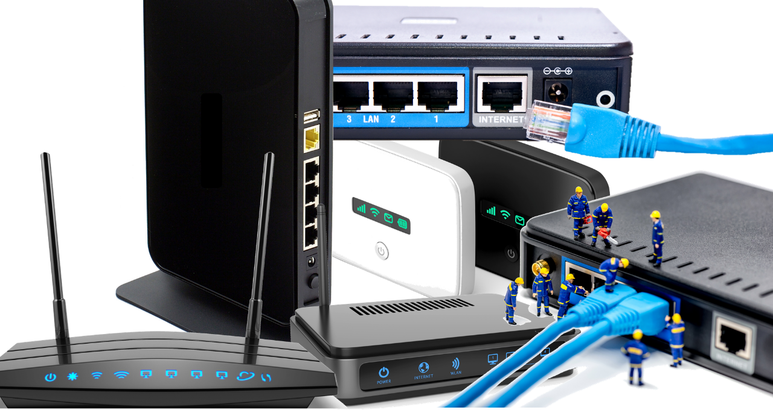
Routers
Routers come in many different shapes and sizes, but they all essentially do the same thing.
Join local area networks (LANs) to the internet with a public IP address
Receive inbound data and direct it to a specific device on a network (LAN)
Direct traffic (packets) from one router to another using IP addresses
Pass local data on to an external network (internet)

Slide 3
Routers
A typical router will have:
A cable connecting it to the internet.
Several other cables connecting to computers and other devices on the LAN.
Wireless connectivity.

Slide 4
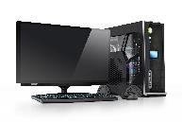
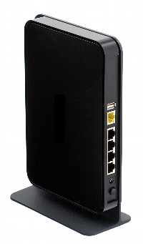
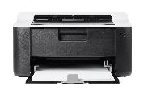

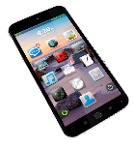

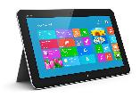
Routers
192.168.0.2
192.168.0.3
192.168.0.4
192.168.0.1
192.168.0.6
192.168.0.5

Slide 5

Routers
210.4.57.154
192.168.0.2
43.115.19.68
3.14.207.174
192.168.0.3
96.48.12.43
192.168.0.4
192.168.0.1
96.48.12.43
192.168.0.6
192.168.0.5

Slide 6

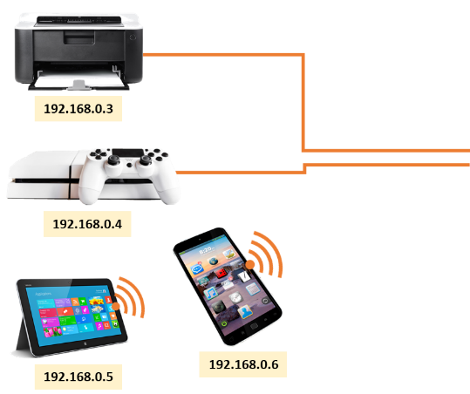

Routers
210.4.57.154
192.168.0.2
43.115.19.68
3.14.207.174
192.168.0.3
96.48.12.43
192.168.0.4
192.168.0.1
96.48.12.43
192.168.0.6
192.168.0.5

Slide 7

Routers
A router sends data between networks – it is required to connect a local area network to a wide area network.
Routers use devices’ IP address to route traffic to other routers.
Routers can assign IP addresses to devices on a local network.

Slide 8


